Slide 1
Group- 3 Sneta Kayastha Siddhartha Nepal
Visualization of University Ranking

Slide 2
Data Sources
Data regarding education where the universities were ranked based on different measures over years
Data from Twitter for some of the Top ranked universities

Slide 3
Challenges you encountered
Getting the data for Twitter Sentiment Analysis
Getting the clean data for the visualization
Cleaning the data
Modify the dataset due to improper format.

Slide 4
Calculated Fields and Parameters
Staff Ratio Calculation
Sort By
Rank International
Count University in a Country
Size of a Country
Rank Research
Top N university
Ideal Student Staff Ratio
Dimension

Slide 5
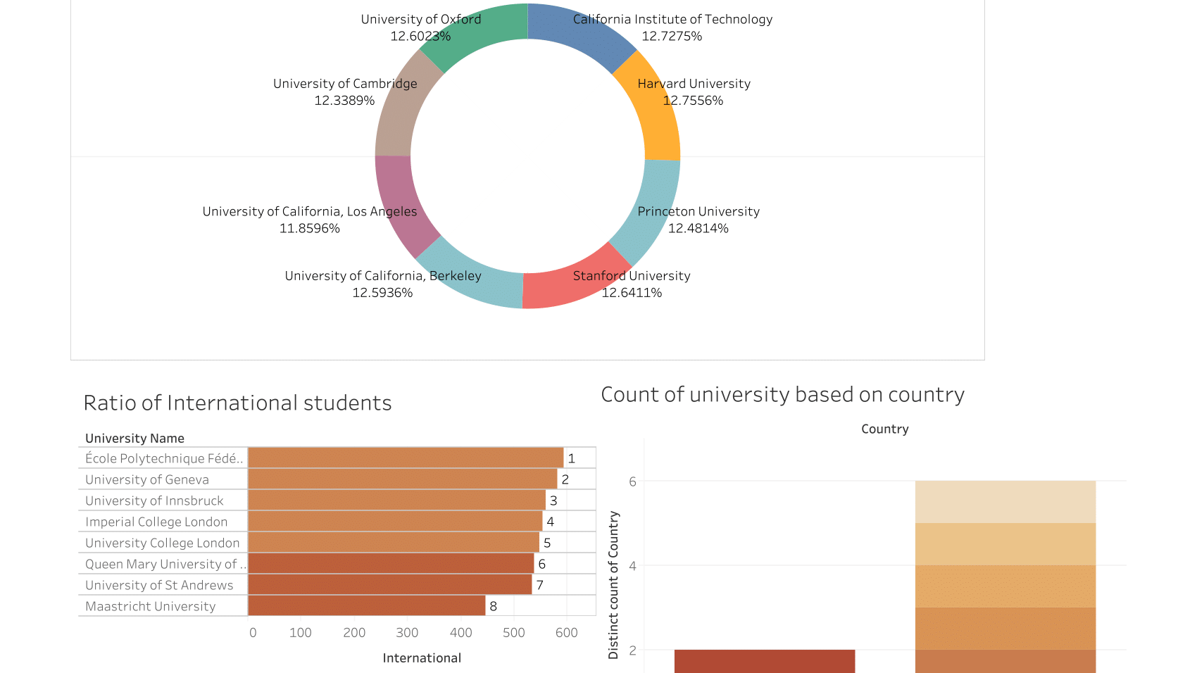

Slide 6
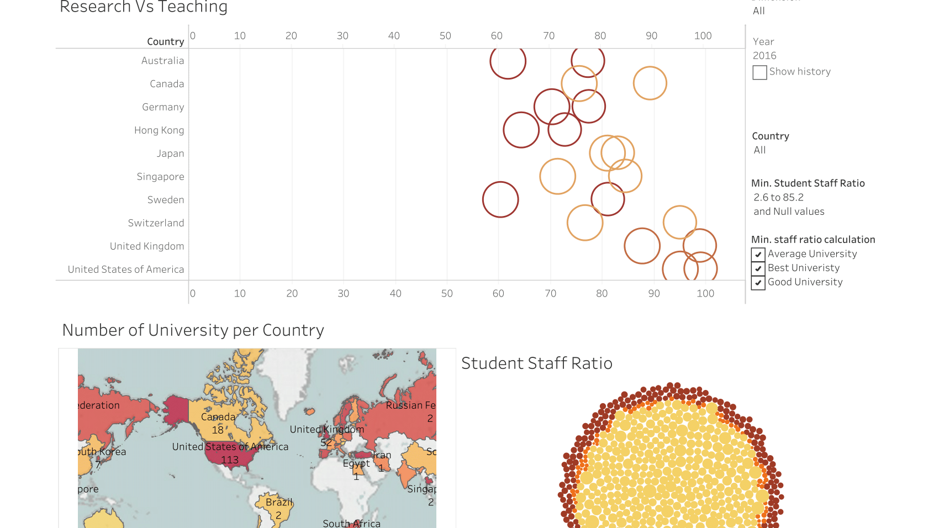

Slide 7
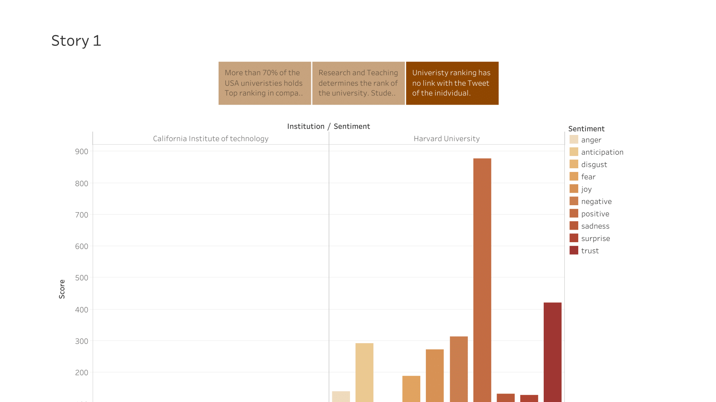

Slide 8
Conclusion
Research and Teaching has greater impact on the university ranking
Number of students and International students doesn’t correlate with the ranking of the university
The ratio of the Top universities in the USA is more than 70% in comparison to all other countries
Top Universities has low student faculty ratio which has an impact on the ranking of the university
Tweets of the individual generated from the Twitter sentiment analysis of the Top universities is not a good measure to learn more about the university.

